Slide 1


Write a Custom Topology in Lab 1
Our assigned topology is as follow
Which has a loop inside
The forwarding application in SDN HUB project is learning switch
Loops could result in broadcast storm during flooding
s3(switch)
s4(switch)
s1(switch)
s2(switch)
h1(host)
h2(host)
h3(host)
h4(host)

Slide 2
For those who use Ryu controller
With our custom topology in this lab, please open Ryu with SimpleSwitchStp13 application
STP requires about 30 seconds to learn
Wait this period after you start Mininet, and then ping can work
Ryubook Spanning Tree
https://osrg.github.io/ryu-book/en/html/spanning_tree.html
$ ryu-manager ryu.app.simple_switch_stp_13

Slide 3
Project 2
OpenFlow Protocol Observation and Flow Rule Installation
Date: | 2019/02/25 (Mon.)
Deadline: | 2019/03/14 (Thu.)

Slide 4
Outline
Observe OpenFlow Messages
Wireshark
On Ryu
On ONOS
Install/Delete Flow Rules with REST
On Ryu
On ONOS
Project 2 requirements

Slide 5
Outline
Observe OpenFlow Messages
Wireshark
On Ryu
On ONOS
Install/Delete Flow Rules with REST
On Ryu
On ONOS
Project 2 requirements

Slide 6
Observe OpenFlow Messages
OpenFlow Protocol Observation and Flow Rule Installation
Notes:
說明有兩種方式 CLI AND restful api

Slide 7
Outline
Observe OpenFlow Messages
Wireshark
On Ryu
On ONOS
Install/Delete Flow Rules with REST
On Ryu
On ONOS
Project 2 requirements

Slide 8

Wireshark
A free and open-source packet analyzer
Installation (Ubuntu should have Wireshark installed)
Open Wireshark
$ sudo apt-get install wireshark
$ sudo wireshark

Slide 9
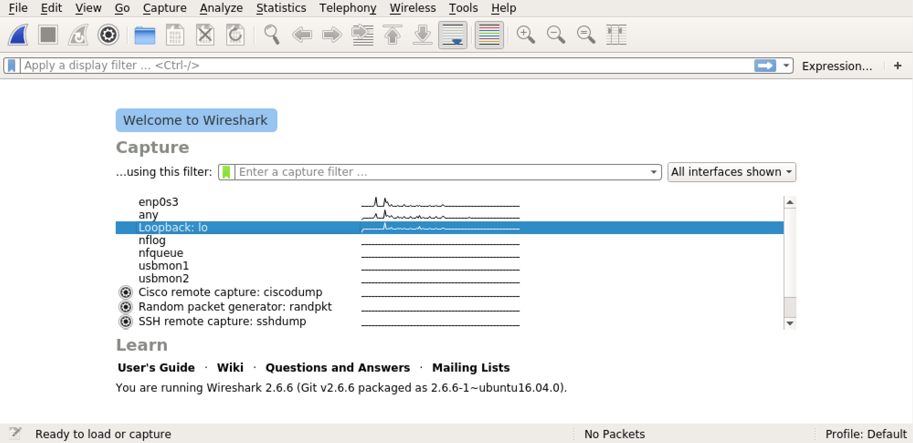
Capture Packets
Capture packets on Loopback interface

Slide 10
Outline
Observe OpenFlow Messages
Wireshark
On Ryu
On ONOS
Install/Delete Flow Rules with REST
On Ryu
On ONOS
Project 2 requirements

Slide 11
Observe OpenFlow Messages on Ryu
Start SimpleSwitch13 application on Ryu
Start Mininet topology
Start capture packets on Loopback interface with Wireshark
Ping a host in Mininet (Please ping h2 from h1 in this lab)
Stop ping and Wireshark to check captured packets
$ cd ryu
$ ryu-manager ryu.app.simple_switch_13
$ sudo mn --controller=remote,127.0.0.1:6653
mininet> h1 ping h2

Slide 12
Outline
Observe OpenFlow Messages
Wireshark
On Ryu
On ONOS
Install/Delete Flow Rules with REST
On Ryu
On ONOS
Project 2 requirements

Slide 13
Observe OpenFlow Messages on ONOS
Start ONOS and check activated application on ONOS CLI
Start Mininet topology
Start capture packets on Loopback interface with Wireshark
Ping a host in Mininet (Please ping h2 from h1 in this lab)
Stop ping and Wireshark to check captured packets
onos> apps –a –s # Check activated application
onos> app activate fwd # Activate ReactiveForwarding
onos> app deactivate proxyarp # Deactivate ProxyARP
$ sudo mn --controller=remote,127.0.0.1:6653
mininet> h1 ping h2

Slide 14
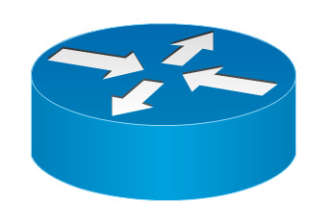

Information for Reference
Command `sudo mn` builds a topology with a switch and two hosts connected
OpenFlow spec 1.3
https://www.opennetworking.org/wp-content/uploads/2014/10/openflow-spec-v1.3.0.pdf
Ryubook SimpleSwitch13
https://osrg.github.io/ryu-book/en/html/switching_hub.html
s1
h1
h2

Slide 15
Outline
Observe OpenFlow Messages
Wireshark
On Ryu
On ONOS
Install/Delete Flow Rules with REST
On Ryu
On ONOS
Project 2 requirements

Slide 16
Install/Delete Flow Rules with REST
OpenFlow Protocol Observation and Flow Rule Installation
Notes:
說明有兩種方式 CLI AND restful api

Slide 17
REST (I)
Representational State Transfer (REST) is a software architectural style for creating Web services
Client-server architecture
Statelessness
Cacheability
Uniform interface
Allow to access and manipulate textual representations of Web resources
HTTP method is used, as is the most common
Payload could be formatted in HTML, XML, JSON

Slide 18
REST (II)
Command `curl` is used to transfer data from or to a server
`<data>` could be a file name if prefixed with `@` character
$ curl –u <user:password> -X <command> -H <header> -d <data> [URL]
$ curl –u <user:password> -X <command> -H <header> -d @<file> [URL]

Slide 19
Outline
Observe OpenFlow Messages
Wireshark
On Ryu
On ONOS
Install/Delete Flow Rules with REST
On Ryu
On ONOS
Project 2 requirements

Slide 20
Ryu Setup
Start SimpleSwitch13 application on Ryu
Start Mininet topology
Check that two hosts cannot ping each other
$ cd ryu
$ ryu-manager ryu.app.ofctl_rest
$ sudo mn --controller=remote,127.0.0.1:6653
mininet> h1 ping h2

Slide 21
Install Flow Rules on Ryu
$ curl -X POST -d '{
"dpid": 1,
"cookie": 1,
"cookie_mask": 1,
"table_id": 0,
"idle_timeout": 30,
"hard_timeout": 30,
"priority": 11111,
"flags": 1,
"match":{
"in_port":2
},
"actions":[
{
"type":"OUTPUT",
"port": 1
}
]
}' http://localhost:8080/stats/flowentry/add

Slide 22
Delete Flow Rules on Ryu
Delete all matching flow entries of the switch
The fields to match depend on what kind of flows to delete
Delete all flow entries of the switch which specified with Datapath ID in URI (/stats/flowentry/clear/<dpid>)
$ curl -X POST -d '{
"dpid": 1,
"cookie": 2,
"cookie_mask": 1,
}' http://localhost:8080/stats/flowentry/delete
$ curl -X DELETE http://localhost:8080/stats/flowentry/clear/1

Slide 23
Outline
Observe OpenFlow Messages
Wireshark
On Ryu
On ONOS
Install/Delete Flow Rules with REST
On Ryu
On ONOS
Project 2 requirements

Slide 24
ONOS Setup
Make sure forwarding application is deactivated
Start Mininet topology
Check that two hosts cannot ping each other
onos> apps -a -s # Check activated application
onos> app deactivate fwd # Activate ReactiveForwarding
$ sudo mn --controller=remote,127.0.0.1:6653
mininet> h1 ping h2

Slide 25
Create a JSON file of flow rules
{
"priority": 40000,
"timeout": 0,
"isPermanent": true,
"deviceId": "of:0000000000000001",
"treatment": {
"instructions": [
{
"type": "OUTPUT",
"port": "2"
}
]
},
"selector": {
"criteria": [
{
"type": "IN_PORT",
"port": "1"
}
]
}
}
Notice that this is the content of your JSON file of flow rules, not commands on terminal!

Slide 26
Install Flow Rules on ONOS
Install flow rules on ONOS with JSON file say `flows1.json`
$ curl -u onos:rocks -X POST -H “Content-Type: application/json” -d @flows1.json http://localhost:8181/onos/v1/flows/of:0000000000000001
Please type the command yourself.
Do not copy and paste since the quotation marks (“) could be different!

Slide 27
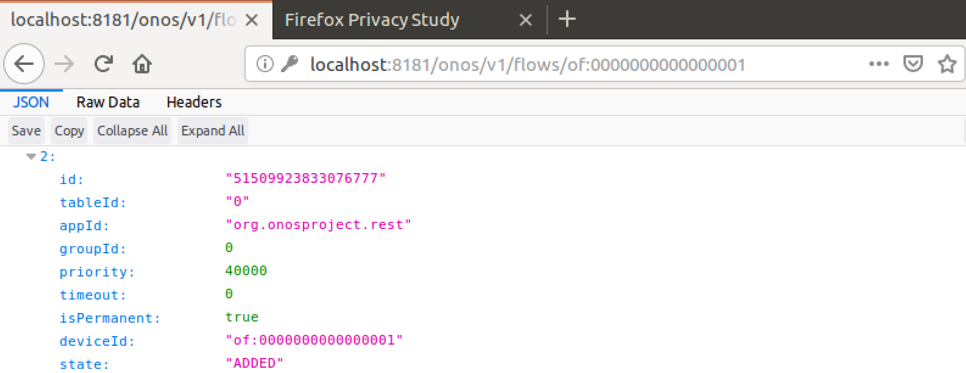
Delete Flow Rules on ONOS (I)
Find flow ID of the flow rule to delete on http://localhost:8181/onos/v1/flows/of:0000000000000001
`curl` could also be used
In this example, flow ID is 51509923833076777.
$ curl -u onos:rocks -X GET -H “Accept: application/json” http://localhost:8181/onos/v1/flows/of:0000000000000001

Slide 28
Delete Flow Rules on ONOS (II)
Delete the flow rule with flow ID
$ curl -u onos:rocks -X DELETE -H “Accept: application/json” http://localhost:8181/onos/v1/flows/of:0000000000000001/ 51509923833076777

Slide 29
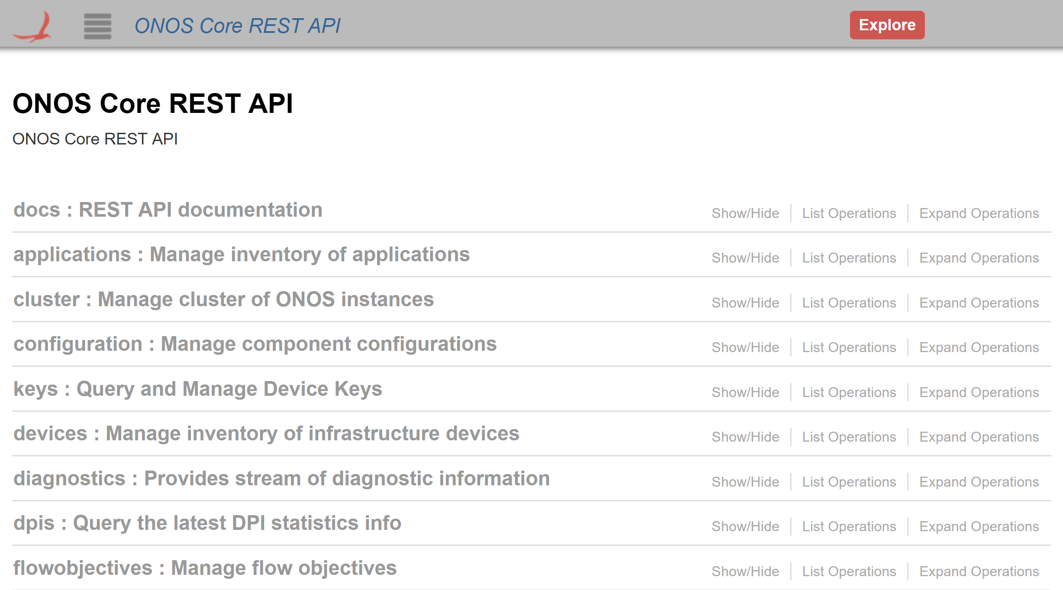
ONOS REST API on Web UI (I)
Browse http://127.0.0.1:8181/onos/v1/docs

Slide 30
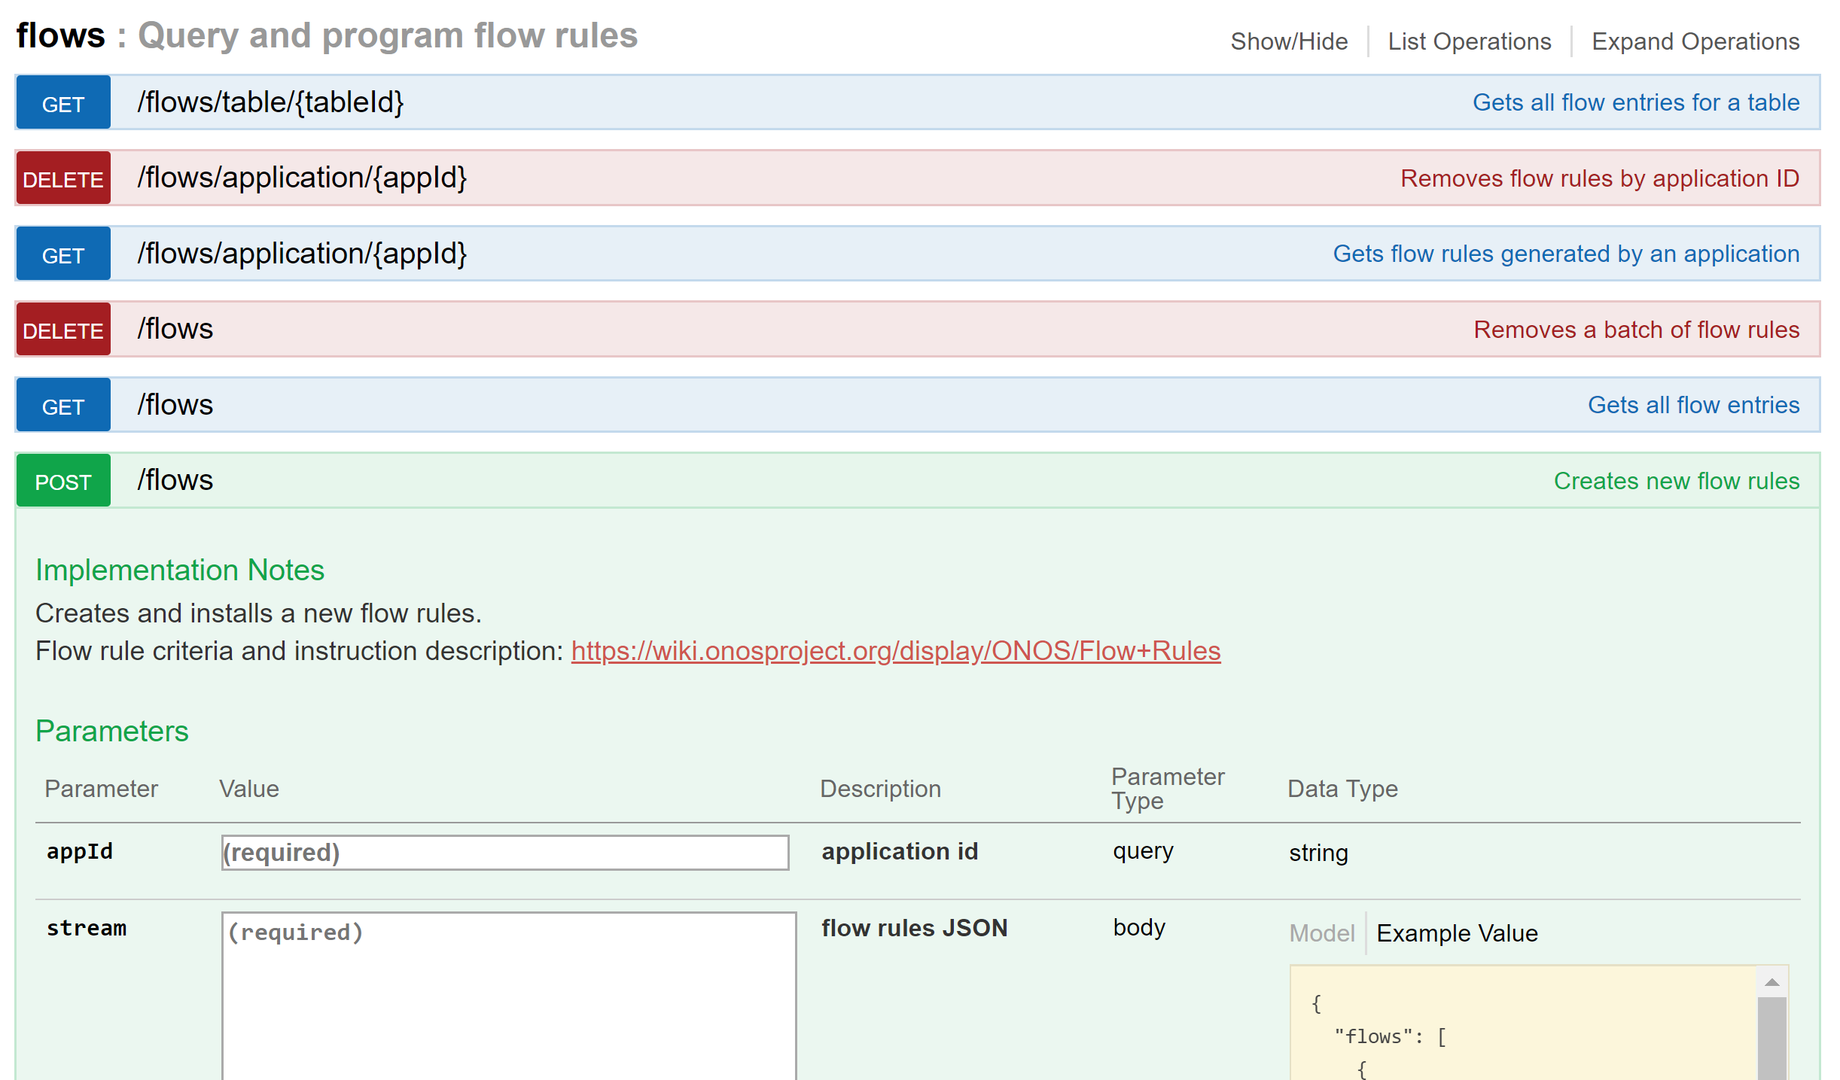
ONOS REST API on Web UI (II)
Fill out required fields (`appID` could be arbitrary string)

Slide 31
Information for Reference
Manpages for command `curl`
http://manpages.ubuntu.com/manpages/xenial/man1/curl.1.html
Ryu REST API application
https://ryu.readthedocs.io/en/latest/app/ofctl_rest.html#
ONOS REST API
https://wiki.onosproject.org/display/ONOS/Appendix+B%3A+REST+API
Notice that the priority should be less than 65535

Slide 32
Outline
Observe OpenFlow Messages
Wireshark
On Ryu
On ONOS
Install/Delete Flow Rules with REST
On Ryu
On ONOS
Project 2 Requirements

Slide 33
Project 2 Requirements
OpenFlow Protocol Observation and Flow Rule Installation
Notes:
說明有兩種方式 CLI AND restful api

Slide 34
Answer Questions – ONOS/Ryu
How many Flow-Mod messages are installed in captured packets?
What are the matching fields and the corresponding actions in each of Flow-Mod messages?
What are the idle timeout, hard timeout and priority of all Flow-Mod messages?

Slide 35
Install Flow Rules (I)
Install following flow rules to forward ARP packets
Matching fields
Ethernet frame type (ARP)
Actions
Output from port
Verify your installed flows
mininet> h1 arping h2

Slide 36
Install Flow Rules (II)
Install following flow rules to forward IPv4 packets
Matching fields
IPv4 destination address
Actions
Output from port
Verify your installed flows
Notice possible timeout for previously installed flow rules
mininet> h1 ping h2

Slide 37
Bonus (I)
Please try to figure out what happens with data and control planes from starting to ping to the first ICMP packet that two hosts are able to reach each other
Include the mechanism why each packet in this period is generated
Please write down each decisions made by data and control plane in details
This involves the designs of Ryu/ONOS applications
ONOS ReactiveForwarding
https://github.com/opennetworkinglab/onos/blob/master/apps/fwd/src/main/java/org/onosproject/fwd/ReactiveForwarding.java
Ryu SimpleSwitch13
https://github.com/osrg/ryu/blob/master/ryu/app/simple_switch_13.py

Slide 38
Bonus (II)
Ryu
You should find the first Packet-In packet from ICMP request. However, why there is no Packet-In packet from the following ICMP response?
One Packet-In packet should theoretically trigger Packet-Out and possibly the following Flow-Mod packet. However, you should find that the number of Packet-Out is less than that of Flow-Mod. What is the mechanism and why it is implemented?

Slide 39
Bonus (III)
ONOS
You should find there is one Packet-In packet from ICMP request without Packet-In packet from the following ICMP response. Why?
How does ONOS decide ports where packets should be forwarded?
Hint for ONOS: a period of lag should be predicted since the mechanism of ReactiveForwarding

Slide 40
Submit to e3
Files
A report: project2_studentID.pdf
Take screenshots of your captures from Wireshark (OpenFlow messages)
Answer the questions in details
Record your process of installing flow rules (include JSON)
Write down what you learn or solve
Submit
Upload “.zip” file to e3
Named: project2_studentID.zip
Wrong file name or format would not be scored

Slide 41
Thank you
Q & A

